Slide 1
Worker care Spectrum
Ability Management
Dr. Sanskruti Tahakik
Dept. Of Community Physiotherapy
Mgm Institute Of Physiotherapy
Chh. Sambhajinagar

Slide 2
Objectives
To understand what is worker care Spectrum &
What is ability Management.

Slide 3
Contents
What is Worker care Spectrum.
What is ability Management.
Why it is Important to study Ability Management.

Slide 4
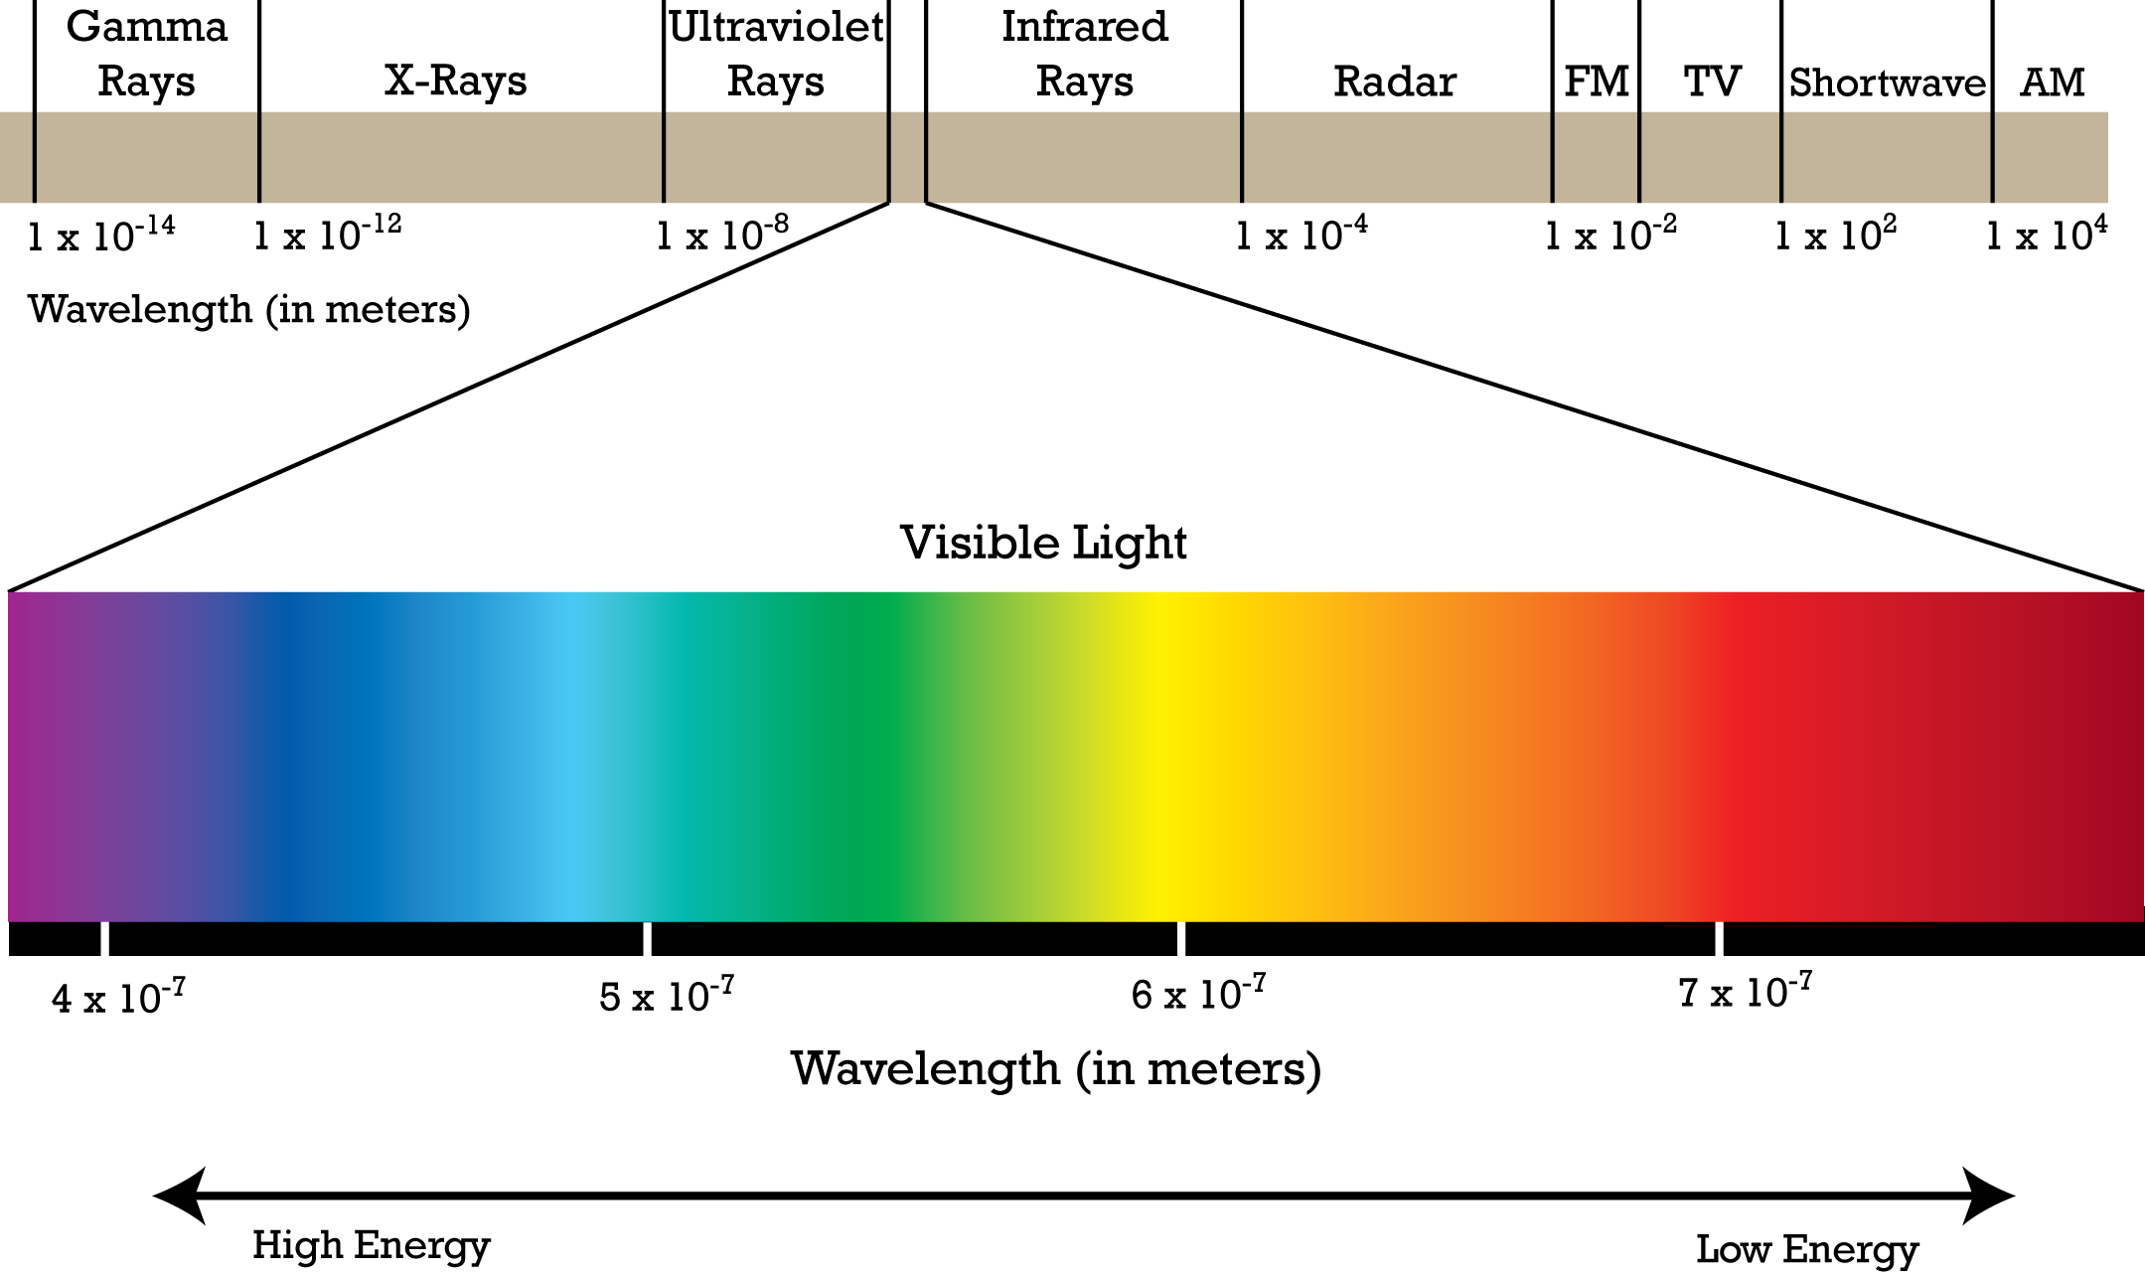

Slide 5
Introduction
Spectrum is Condition that is Not Limited to a specific set of values but can vary, without steps across continuum.
Like spectrum of light having light of all wavelengths.

Slide 6
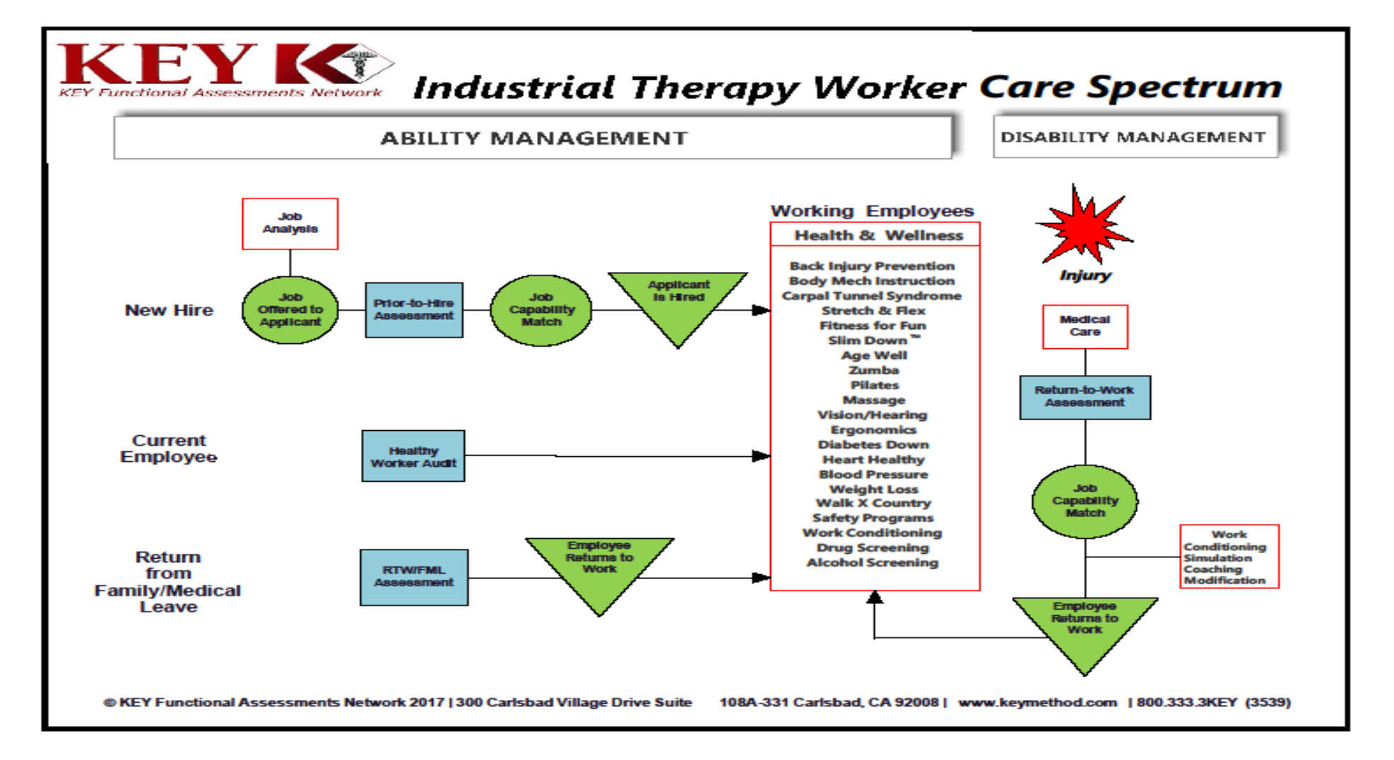

Slide 7
Ability Management:
Placement & Prevention
Educating & Training
Job Analysis
Work Conditioning
Placement
Job Offer
Job Description
Job Placement Assessment
Job Modification

Slide 8
Job Analysis
Is the Foundation for most aspects of industrial therapy.
The term Job analysis refers to The total analysis continuum of which Job Demand Analysis (JDA), Task Analysis (TA) and Ergonomic Evaluation (EE) are Subsets.

Slide 9
Job Demand Analysis
A Checklist or Itemization of the Physical Demands of the Job in General.
Task Analysis
A detailed inventory of the frequency, Duration, and Forces required to meet the major demands of the job.
Ergonomic Evaluation
A mathematical analysis of the Physical aspects of the job which might be considered hazardous based on the above Analysis.

Slide 10
Job demand analysis
Is an Objective and systematic procedure to identify the demands of the job can include basic Physical demands (Lifting , carrying, Pushing and Pulling).
Sensory and perceptual Demands ( Hearing and Vision)
Vocational requirements and environmental conditions
( exposure to heat, Cold and vibrations).

Slide 11
Task Analysis
TA measures in more details the frequency, Duration and Forces generated.
TA Provides a Detailed picture of the demands placed on the worker by a Particular task.

Slide 12
Ergonomic Evaluation
Is a mathematical analysis of any aspect of a job that is identified during the JDA as “ Hazardous” or of “risk” to the Worker.

Slide 13
Job Description
A Written or verbal description of the functions of the Job.
The worker should Know prior what kind of Job he need to do and what is requirement of the job.

Slide 14
Job Placement Assessment
Objectively measures the worker’s capabilities in a variety of tasks related to the jobs available.
There are a number of Functional Capacity Assessments(FCA), Physical capacity evaluations, work assessments.

Slide 15
Work Conditioning
Work conditioning: It is defined as programs focusing on physical issues of flexibility, strength, endurance, coordination and work related functions for the goal of returning to work.

Slide 16
Job Modification
Physical Accommodation – Ergonomic designed chairs or supportive equipment.
Environmental- Temperature adjusted.
Work site modifications.
Job restructuring – Reassigning tasks.
Work activities modification – Altering time or work Hours.

Slide 17
Answers from you..
Explain ability management.
Elaborated Job Analysis Continuum.

Slide 18
Refer this book
Industrial Therapy by Glenda L. Key, second edition.

Slide 19
Thank You..!!

